Slide 1
PROPERTY MANAGEMENT APPLICATION USING SALESFORCE
Team lead: M. Sneka
Team member 1:V.Risha
Team member 2:V.Santhiya
Team member 3:S.Manobala

Slide 2
INTRODUCTION
A property management system[PMS]
is a software that facilitates a hotel’s reservation
Management and administrative tasks.
The most important functions are include:
Front desk operations
Channel management
House keeping
Reservations
Rate and occupancy management
Payment processing
etc..

Slide 3
PURPOSE
The use of this project.
The main use of this project is save our time.
To reduce paper misplacement.

Slide 4
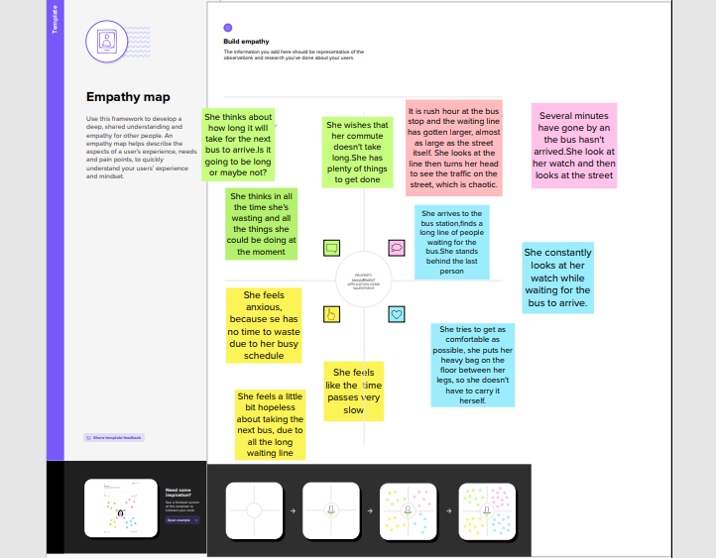
EMPATHY MAP

Slide 5
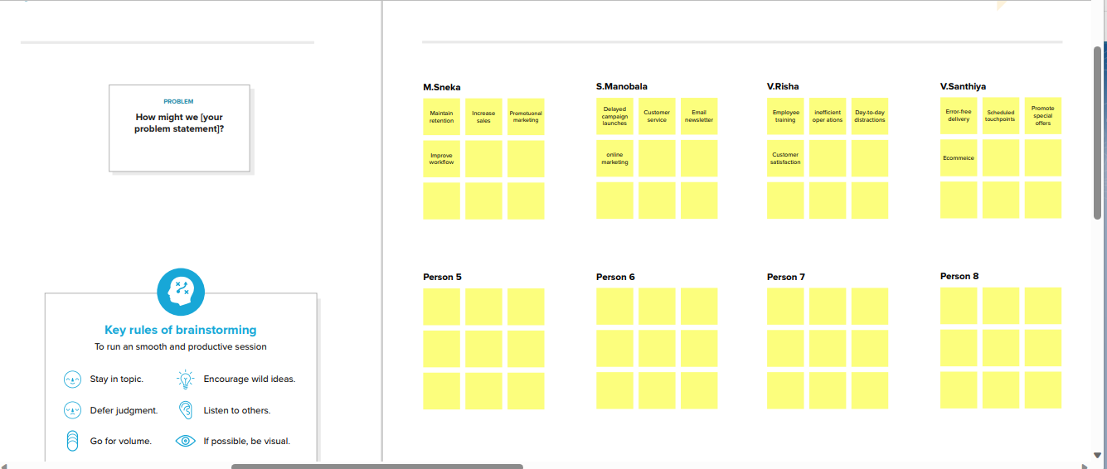
BRAINSTORMING

Slide 6
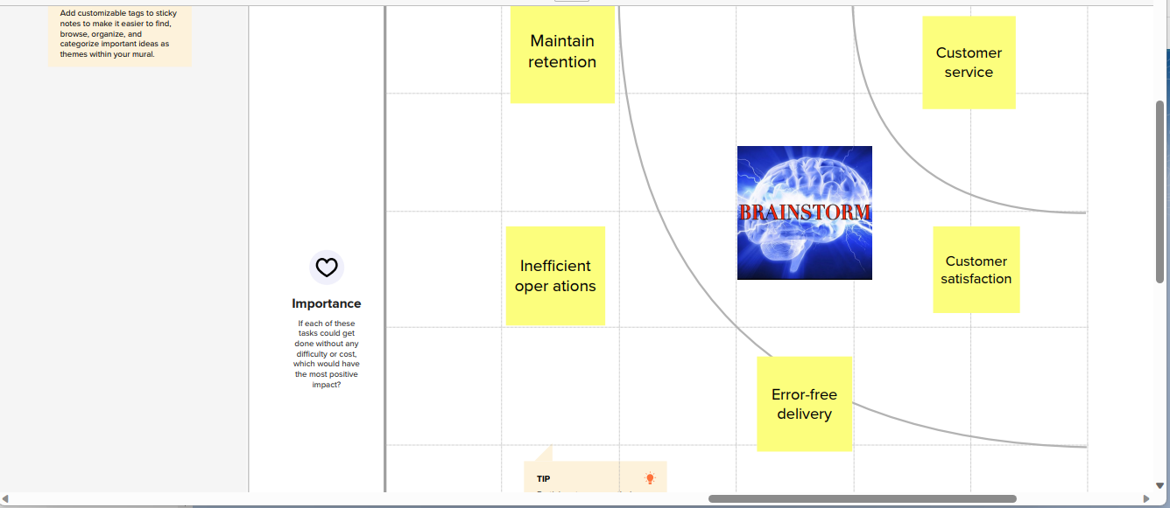
MAP

Slide 7
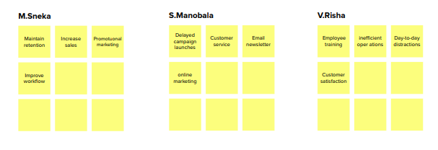
BRAIN STORMING

Slide 8
RESULT
OBJECT NAME | FIELDS IN THE OBJECT
 | FIELD LABEL | DATA TYPE
1. Standard Object | Loan Amount | Formula
 | Discount | Percentage
2. Custom Object | Rental City | Text
 | Rent | Auto Number
 | Term | Number

Slide 9
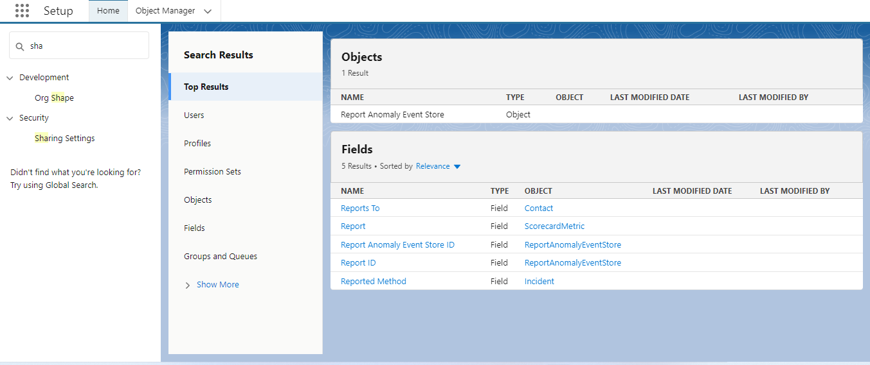
OBJECT
Salesforce objects are database tables that permit you to store data that is specific to an organization.

Slide 10
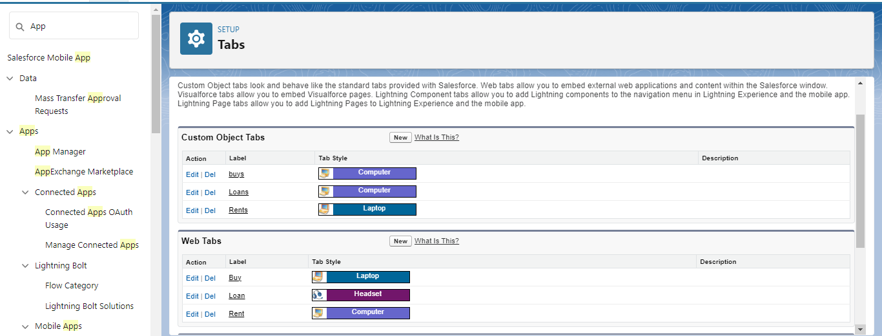
Tab
A tab is like a user interface that is used to build records for objects and to view the records in the objects.

Slide 11
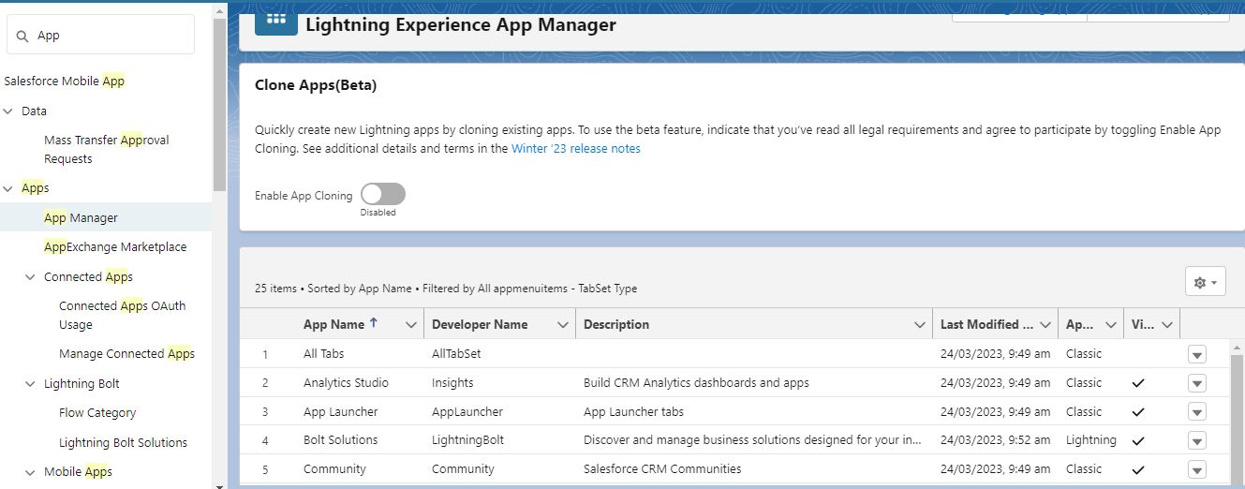
LIGHTNING APP
An app is a collection of items that work together to serve a particular function.

Slide 12
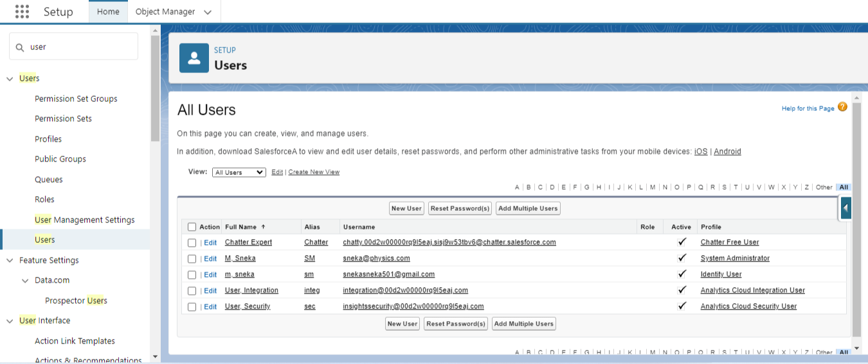
USERS
A user is anyone who logs into sales force. Users are employees at your company, such as sales reps, managers, and IT specialists, who need access to the company’s records.

Slide 13
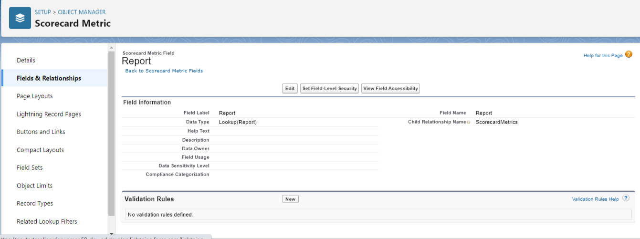
REPORTS
Reports give you access to your Salesforce data.

Slide 14
TRAILHEAD PROFILE
Team lead- https://trailblazer.me/id/snekm2
Team members:
https://trailblazer.me/id/rishi743
https://trailblazer.me/id/msanthiya2
https://trailblazer.me/id/mbala308

Slide 15
ADVANTAGES
Greater efficiency.
Better service.
Minimum time required.
Security of data.
Manual work has to be reduced.
Application of less manpower.
Result to be received very quickly.

Slide 16
DISADVANTAGES
Tourism Management system is implement in Manual, so the response is very slow.
Tourism Management system is the transaction reports of the system can be retried as and when required. Thus, there is no delay in the availability of any information.
The existing Tourism Management system only provides text-friendly as Graphical user Interface.

Slide 17
APPLICATION
Develop an App for the Property Management where Buyer can order his Requirements and get the Appropriate Details of the Property. According to his interest just provide him with some discounts up to what extent he can get the discount. Also Track Whether he is Interested in taking the loan available for so just calculate how much loan Amount user can get it. Provide the Security for two different profiles like for marketing and sales team. Then Finally Create the reports and dashboard so there will be clear view just get the reports on the count to loan passed getting the property purchased close the deal

Slide 18
CONCLUSION
In conclusion, Property Management System (PMS) software very crucial for all the Hotels. Especially Opera PMS constitutes the most appropriate PMS software for Hilton Athens. It is user friendly, connected with Central Reservation System (CRS) , Point of Sale (POS) etc. And provides all the tools the hotel needs in order to operate effectively. The disadvantages of the Opera PMS can be improved easily and as it was mentioned before a recommendation is the upgrade of Opera V5 to Opera 9.

Slide 19
FUTURE SCOPE
Project manager.
System developer...

